Slide 1
Parallel Vector Addition
using OpenMP
Parallel Computing Mini-Project | Lab Evaluation
Team 1 | B.Tech CSE (AI & Engineering), 3rd Year
Team Member | USN
Bhakti | 01FE24BCI079
Shifa | 01FE24BCI004
Soumya | 01FE24BCI005
Sumanth | 01FE24BCI085

Slide 2
1. Problem & Sequential Algorithm
Problem: add two large vectors A and B element by element to get C
C[i] = A[i] + B[i] for i = 0 … N-1
Time complexity O(N); every element is independent
Goal: reduce execution time using multiple threads and measure speedup
// sequential baseline
for (int i = 0; i < N; i++) {
C[i] = A[i] + B[i];
}
// timing
gcc sequential.c -o sequential
Team 1 | Parallel Vector Addition (OpenMP)
2

Slide 3
2. Parallel Design (OpenMP)
Shared-memory model: all threads see A, B and C
No data dependency between iterations, so the loop is data-parallel
No race conditions: each thread writes a different C[i]
Thread count controlled using num_threads(T)
Thread 0
i = 0 … N/4
Thread 1
N/4 … N/2
Thread 2
N/2 … 3N/4
Thread 3
3N/4 … N
Team 1 | Parallel Vector Addition (OpenMP)
3

Slide 4
3. Implementation
Compile with –fopenmp
Vector sizes and thread counts were varied manually during experiments.
Results verified against sequential output
Timings saved to results./*csv
#include <omp.h>
double start = omp_get_wtime();
#pragma omp parallel for
for (int i = 0; i < N; i++)
C[i] = A[i] + B[i];
double end = omp_get_wtime();
//Compile:
gcc -fopenmp parallel.c -o parallel
Run:
./parallel
Team 1 | Parallel Vector Addition (OpenMP)
4

Slide 5
4. Experiments & Measured Data
Experiment 1: data size (default threads)
Experiment 2: thread count (N = 10,000,000)
Vector size | Sequential | OpenMP
100,000 | 0.000237 s | 0.016487 s
1,000,000 | 0.003021 s | 0.011890 s
10,000,000 | 0.030084 s | 0.023357 s
Threads | Time | Speedup | Efficiency
1 | 0.029162 s | 1.00x | 100%
2 | 0.015312 s | 1.90x | 95.2%
4 | 0.008661 s | 3.37x | 84.2%
8 | 0.023319 s | 1.25x | 15.6%
Speedup S = T(1) / T(p) Efficiency E = S / p
Best result: 4 threads, 0.008661 s (3.37× speedup over 1 thread).
Team 1 | Parallel Vector Addition (OpenMP)
5

Slide 6
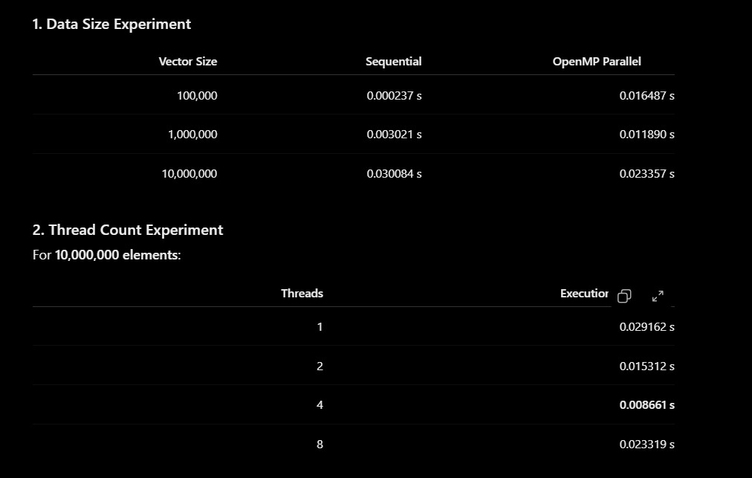
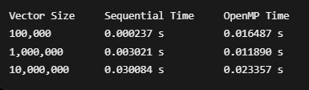
5. Program Output (Screenshots)
Data size experiment: terminal output
Data size and thread count results
Team 1 | Parallel Vector Addition (OpenMP)
6

Slide 7
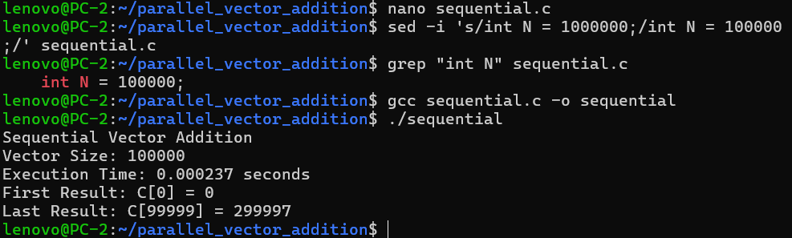
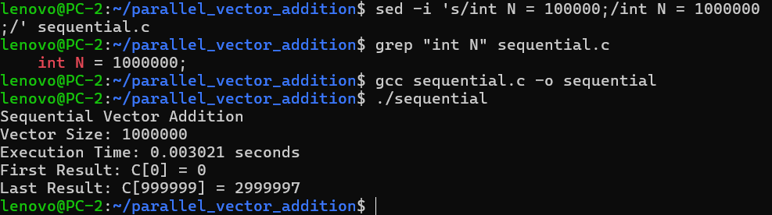

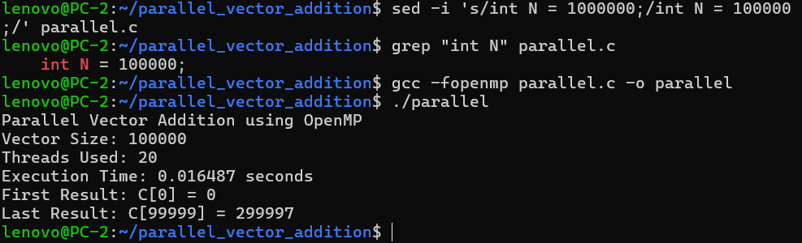
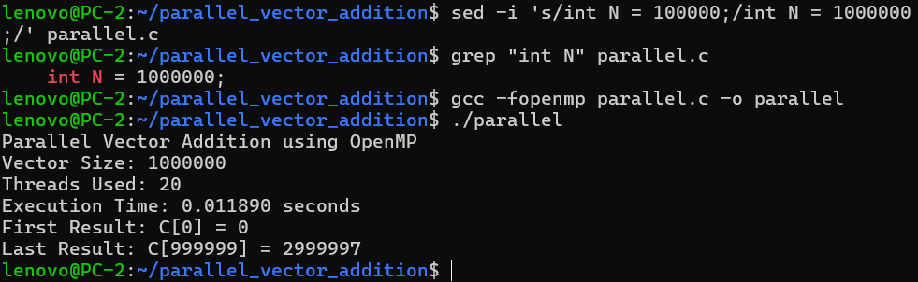
Program Output Evidence — Data Size Experiments
Sequential — 100K
Sequential — 1M
Sequential — 10M
OpenMP — 100K
OpenMP — 1M
Experiment output evidence

Slide 8
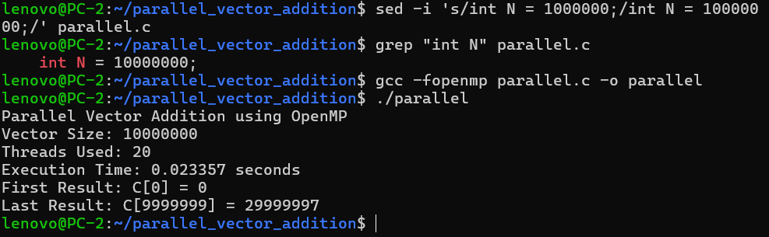
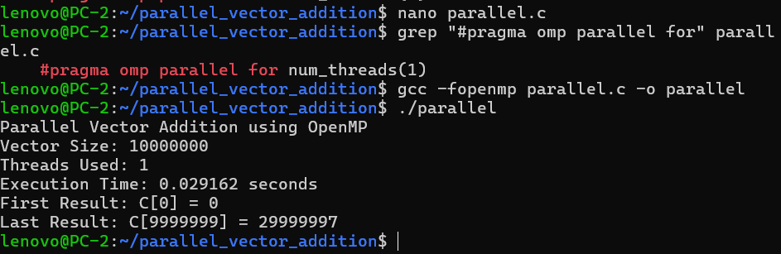
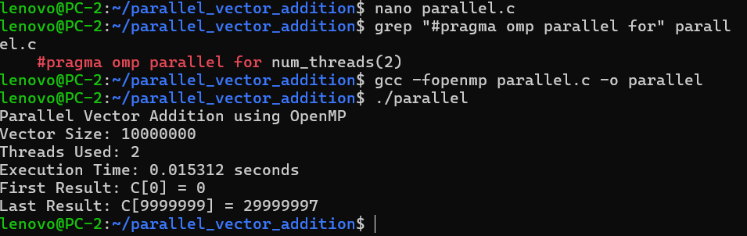
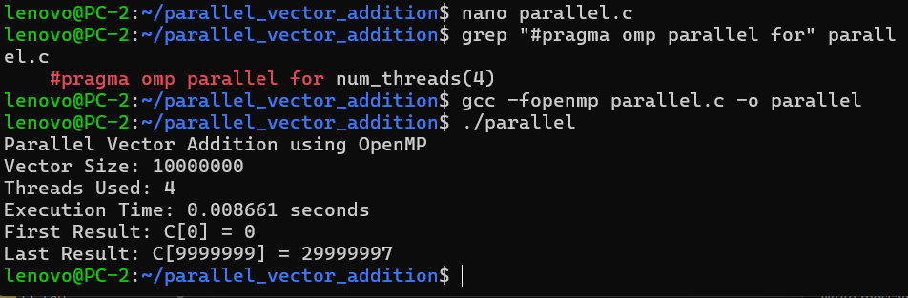
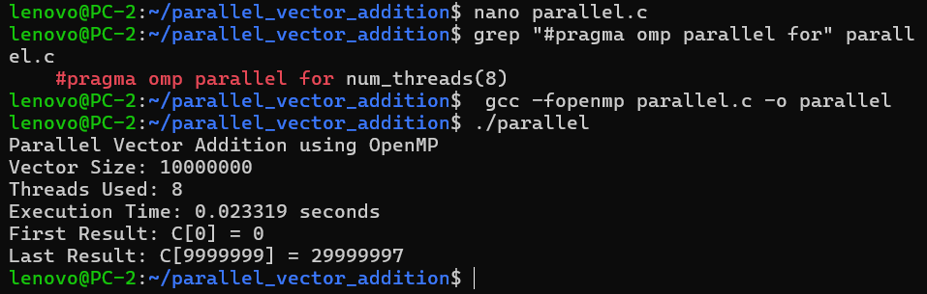
Program Output Evidence — OpenMP & Thread Count
OpenMP — 10M
OpenMP — 1 Thread
OpenMP — 2 Threads
OpenMP — 4 Threads
OpenMP — 8 Threads
Experiment output evidence

Slide 9
6. Execution Time Graphs
OpenMP is slower than sequential for 100K and 1M elements (thread overhead), and only wins at 10M.
Time falls from 0.0292 s to 0.0087 s at 4 threads, then rises to 0.0233 s at 8 threads.
Team 1 | Parallel Vector Addition (OpenMP)
7
Notes:
Left graph: effect of data size. Right graph: effect of thread count at N = 10M. Point out the 8-thread slowdown.

Slide 10
7. Speedup Analysis
Speedup S = T(1) / T(p). At 4 threads: 0.029162 / 0.008661 = 3.37x, the best result and close to ideal (4x). At 8 threads speedup falls to 1.25x.
"3.37× speedup over the 1-thread execution."
Team 1 | Parallel Vector Addition (OpenMP)
8
Notes:
Speedup is measured against the 1-thread OpenMP run. Ideal speedup equals the thread count.

Slide 11
8. Efficiency Analysis
Efficiency E = S / p
2 threads: 1.90 / 2 = 95.2%
4 threads: 3.37 / 4 = 84.2%
8 threads: 1.25 / 8 = 15.6%
Efficiency drops as threads are added: each thread does less work while overhead stays.
At 8 threads most of the time is overhead and memory contention, so efficiency collapses.
Sweet spot for this machine: 4 threads.
Team 1 | Parallel Vector Addition (OpenMP)
9
Notes:
Efficiency tells how well each thread is used. 100% means perfect scaling.

Slide 12
9. Result Analysis
Small data (100K, 1M): OpenMP was slower than sequential. Thread creation and scheduling cost more than the tiny workload.
10M elements: OpenMP (0.0234 s) finally beat sequential (0.0301 s), but only by about 1.3x.
Thread scaling: 2 threads gave 1.90x (95% efficient) and 4 threads gave 3.37x (84%), close to ideal.
8 threads was slower than 4 (1.25x, 15.6% efficiency). Overhead, CPU scheduling and shared memory bandwidth limit the gain.
Vector addition does very little work per element, so it is memory-bound. More threads cannot fix that.
Team 1 | Parallel Vector Addition (OpenMP)
10

Slide 13
10. Conclusion & Demo
OpenMP speeds up vector addition with one pragma, but only for large N.
Best configuration: 4 threads, 3.37x speedup, 84.2% efficiency.
More threads is not always faster: 8 threads performed worse than 4.
Live demo: run sequential vs parallel, show timings and graphs
GitHub repo: README, src/, data/, results/, graphs/, presentation/
Thank you | Questions?
Team 1 | Parallel Vector Addition (OpenMP)
11

